Slide 1



VIRTUAL REALITY
WELDING TRAINING
CODED WELDER: OFO 651202-02
KM-08: SAFELY USE, CARE AND STORE ENGINEERING MEASURING EQUIPMENTS, NQF LEVEL 2, CREDITS 3

Slide 2
ABOUT THIS MODULE
The main focus of the learning in this knowledge module is to safely use, care and store a range of engineering measuring equipment used for measuring such as measuring tape verniers, callipers, rules, combination set, spirit level, plumb bob, micrometers, dial gauges, feeler gauges, thermometers, scales, go/no go gauges, thread gauges, pressure gauges in a safe lock up designated area The learning will enable learners to demonstrate an understanding of:
KM-08-KT01: Safely use engineering measuring equipment (60%)
KM-08-KT02: Apply care and maintenance of engineering measuring equipment (30%)
KM-08-KT03: Store engineering measuring equipment in a safely designated area (10%)

Slide 3
KM-08-KT01: Safely use engineering measuring equipment
Topic elements to be covered include:
KT0101 Demonstrate safe working practices, apply worksite practice and generic health, safety and environmental protection concepts prior to commencement using of engineering measuring equipment’s
KT0102 Identify, select, and safely use engineering measuring equipment’s as recommended by the manufacturer to meet the task descriptions.
KT0103 Explain and discuss basic units of measure and symbols
KT0104 Explain Basic units of measure, symbols and derived units of measure
KT0105 Faulty measuring equipment identified, and corrective action taken

Slide 4
KT0101 Demonstrate safe working practices, apply worksite practice and generic health, safety and environmental protection concepts prior to commencement using of engineering measuring equipment
Work environment is risky; understanding tool and equipment usage is crucial.
Adhere to specified safety measures for each tool and machine.
Measures designed for personal and equipment protection.
It is key that all welders adhere to the general safety measures and measures when using measuring equipment as:
Negligence causes accidents; develop safe working habits.
Prioritize responsibility and colleagues' well-being.
Professional attitude toward job and working environment is crucial.

Slide 5
Review Assessment Activity
Name three ways in which you can avoid accidents with sharp or pointed tools.
Why do bench workers have accidents? Give three reasons
Give two reasons why you must wear safety shoes in a machines shop.
Why must you wear safety glasses in a machine shop? Give two reasons
Why is it safer to roll up your sleeves than to button them in a machine shop?
You must not operate a machine if its guards have been removed. Why not? Give two reasons

Slide 6
Safety precautions for Ventilation, Gases, and Dust:
Harmful Air Precautions:
No one should be in an area with harmful air without approved protective apparatus.
Effective equipment approved by the Director-General is mandatory to prevent inhalation.
Concentration Limits:
Prohibited to work where dust, fumes, or gases exceed specified concentrations.
Approved protective gear is necessary in such areas to prevent inhalation.
Dust Management in Workshops:
Workshops generating harmful dust must maintain cleanliness.
Adequate ventilation or dust extraction systems should be in place.
Gases in Workshops:
Adequate ventilation or safety measures are essential where toxic or flammable gases are present.
Ensuring the safety and health of individuals is a priority.

Slide 7
KT0102 Identify, select and safely use engineering measuring equipment as recommended by the manufacturer to meet the task descriptions. The skills common to both light and heavy fabrication industries include:
Interpretation drawings
Job planning
Calculation of material cutting sizes
Marking out techniques
Development of patterns
Use hand cutting tools
Use of cutting equipment
Cutting materials
Forming materials
Joining techniques
Safety precautions

Slide 8
(a) Interpretation drawings
All jobs start with a drawing. The drawing can be detailed or a sketch. They show information on things such as:
Dimensions
Material type, size and section
Specifications and tolerances
Surface finishes
Drawing standards
Any changes to the drawing

Slide 9
(b) Job planning
To manufacture a job, a number of the following things need to be done:
Interpret drawings
Identify the tasks to be done
Organize equipment, tools and material for the job
Sequence the tasks
Make the working drawings/model
Develop patterns.

Slide 10
(c) Calculation of material cutting sizes
Calculation Methods:
Overall or outside measurements
Inside measurements
Nominal sizes
Importance of Fabrication within Tolerances:
Essential for meeting design needs
Ensures accurate fitting of job components
Facilitates precise on-site positioning and assembly.
Specifications Significance:
Guides on finish quality, painting, welding, and testing requirements.
Understanding Tolerances:
Tolerances indicate allowable variation from specified dimensions.
Example: If a component dimension is 3010 mm with a tolerance of ±1 mm, acceptable dimensions range between 3009 and 3011 mm.

Slide 11
(d) Marking out techniques
Accurate Measurements is key for all welds as precision is crucial to meet specifications. Utilize progressive marking for accuracy.
It also provides centerlines significance key to aid in locating hole centers, squaring plate edges, and geometric construction. Also assist to identify part positions and errors in cutting or marking.
Accumulative Error Mitigation:
Prevent final measurement discrepancies (short or long).
Address through geometric construction and progressive measurement from a common datum point.

Slide 12
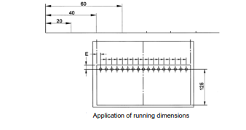
Marking out techniques (p2)

Slide 13
(e) Template development methods
When manufacturing components that change their shape, patterns will have to be developed. A pattern is a piece of metal which is cut to the exact size and shape in order to be formed into the product desired.
These patterns are developed by the light and heavy fabricators, using the three development methods:
Parallel line
Radial line
Triangulation.
Fabrication workers in the both heavy and light industries use common marking out tools.

Slide 14
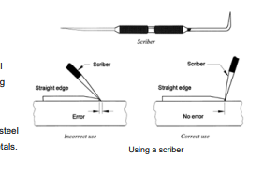
(f) Line marking techniques
Scribed lines – is done by using a sharp and hardened tool for making thin, permanent lines accurately.
Limitations of scribed lines include:
Is hard to see when you’re thermal cutting – you need witness popping
The surface of the metal must be repainted if a mistake is made
Can cause corrosion on stainless steel
Should only be used in ferrous metals.

Slide 15
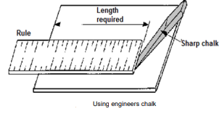
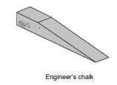
(g) Engineers chalk
Engineers chalk is a hard chalk like material sharpened to a chisel point to make thin, non-permanent lines.
These line are easy to see when thermal cutting, pre- painting the material is not needed, it can be used with most metals and can be rubbed off if a mistake is made.

Slide 16
Engineers chalk (p2)
Limitations of engineer's chalk:
Need to be witness popped for permanency
Can be erased accidentally
Will wash off with water
Can be hard to see on some non-ferrous metals
Chalked lines is a quick method of marking long straight lines on uncoated materials or marking out on concrete floors.
This is done by clamping one end of the string line on to the surface to be marked, pulling the line as taut as possible and clamping it tight, raising the string vertically, letting it drop quickly and re-chalking after each use

Slide 17
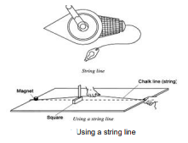
Engineers chalk (p3)
Limitations of chalk lines
Can be erased accidentally.
String may make thick or double lines.
Inaccurate if the technique isn’t used often.
Inaccurate in windy conditions.
Visibility can decrease in the middle, over long distances.
Need witness popping for permanency.
Can only be used on flat surfaces.
Can be hard to see on some non-ferrous metals

Slide 18

(h) Centre punches
These punches are made of tool steel, machined heat treated and ground to give maximum performance.
The steel body is usually knurled for finger grip, diameters range from 5-13 mm depending on the application and they have a round or square head.
Automatic center punches are also available. Metal fabricators use Centre punches to:
Mark out patterns
Locate hole positions
Witness pop when thermal cutting.
Note Do not use a center punch with a mushroomed head.

Slide 19
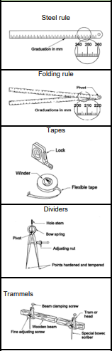
(i) Marking out tools
Steel rule: For accurate measurements over the length of the rule
Folding rule: For accurate measurements over the length of the rule and the transfer of angles.
Tapes: For measurement over long distances.
Dividers: For drawing arcs and circles. For transferring measurements and angles. From one to another. For geometric construction of angles. For geometric division of lines, angles.
Trammels: For constructing large arcs and circles. For transferring measurements and angles. For geometric division of lines and angles.

Slide 20
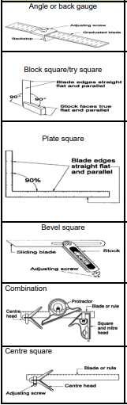
Marking out tools (p2)
Angle or back gauge: For accurately locating gauge line to position items or hole centers.
Block square/try square: For making square lines off plate/sheet edges or existing lines and rolled steel sections.
Plate square: For marking square lines off plate/sheet edges or existing lines.
Bevel square: For transferring angles.
Combination: For marking lines at any angle and locating the center of circular objects.
Centre square: For locating the center of circular objects.

Slide 21
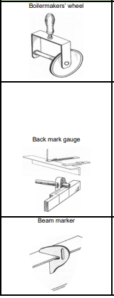
Marking out tools (p3)
Boilermakers’ wheel: The boilermakers’ wheel is used to measure the lengths of curved or irregular surfaces such as the inside circumference of a large tank. Another use for this tool is to measure the actual length of cutting or welding along the edge of a developed pattern for a pipe, cone, or transition piece
Back mark gauge: Back-mark gauge is used to mark the centers of the hole before it is center punched.
Beam marker: The beam marker can be used to mark the centers of the holes, or the centerline of the beam, where required – once the center-line across the length is marked out.

Slide 22
(j) Measuring tools
Various measuring tools are utilized in industry, their accuracy reliant on proper usage and care.
Treat these tools as delicate precision instruments, ensuring careful handling for prolonged accuracy.
Regularly check and verify the accuracy of the measuring tools you use.
Measurements can be acquired through:
Directly reading a scale visually.
Utilizing measuring tools like calipers or micrometers with contact on the work surface.

Slide 23
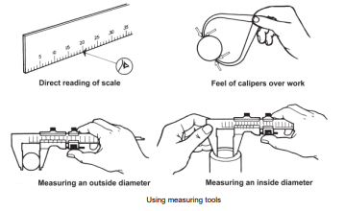
Measuring tools (p2)

Slide 24
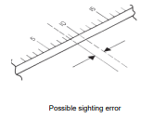
Measuring tools (p3)
Reading scales accurately
To obtain accurate readings every time when taking a direct reading from a scale, take care when sighting the scale.
Parallax
An optical error called parallax must be avoided.
Parallax is the apparent change in the position of an
object viewed against a more distant object

Slide 25
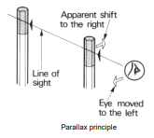
Measuring tools (p4)
Parallax may be demonstrated as follows:
Hold a pencil vertically in each hand, directly in front of you.
Hold one pencil at arm’s length and about 150 mm in front of the other pencil.
Keep your hands steady and close one eye.
Move your head sideways until the two pencils are in line.
Now move your eye to the left and right of this position by moving your head sideways.
Observe how the pencil nearest you appears to change position. This is the optical illusion of parallax. Avoid this illusion when taking readings from scales.

Slide 26
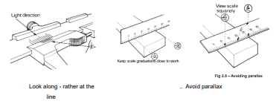
Measuring tools (p5)
Avoiding parallax
Hold the scale so that its graduations are as close as possible to the part being measured.
Sight the graduations squarely off the scale

Slide 27
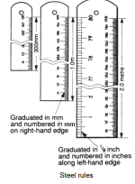
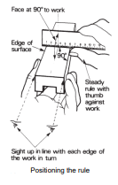
(k) Graduated steel rules
Used for moderate accuracy measurements.
Typically marked with dual graduations (millimeters on one edge, inches and fractions on the other).
Described by length, ranging from 150 mm (6 in) to 2 m (approx. 6 ft 6¾ ins).
Correct usage is crucial for accuracy:
Position the rule at right angles to your eye in good light.
Graduations can be as fine as one millimeter or even half a millimeter.

Slide 28
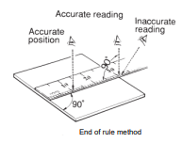
(l) Measuring with a steel rule
End of rule method :
Place the square end of the rule level with one edge of the metal – make sure the rule is at 90° to this edge.
View the scale squarely so an accurate reading is obtained.
The measurement read from the rule is the measurement required.

Slide 29
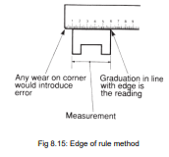
Measuring with a steel rule (p2)
Edge of rule method
-If the rule is worn on the end then the following
method is suggested.
Steady the work with your left hand.
Hold the rule with your right hand and steady it with your right thumb against the work.
Place the edge of the rule on the surface so that the face of the rule is at right angles to the work and square across it.
Sight up the first numbered graduation with the left-hand edge of the work.
Sight up the nearest graduation in line with the right-end edge of the work and take the reading

Slide 30
Measuring with a steel rule (p3)
Other uses for the steel rule
A steel rule can also be used as a:
Guide to draw or scribe a straight line
Straight-edge to test the accuracy of a flat surface scale for setting dividers and other marking out tools

Slide 31
(m) Measuring tapes
Flexible metal blade in a metal or plastic case, coiled with a strong spring.
Used for measuring long distances with reasonable accuracy.
Convenient for longer measurements compared to a steel rule.
Common lengths range from three to ten meters, with longer options like 30 meters.
Some allow inside measurements by adding the case length to the indicated measurement.

Slide 32
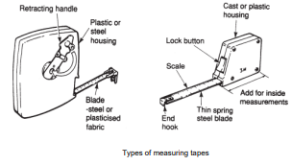
Measuring tapes (p2)

Slide 33
Measuring tapes (p3)
Retracting Mechanisms:
Smaller tapes retract under spring tension when the locking button is released.
Caution needed to avoid violent snap back; restrain by guiding the tape with hand.
Non-spring-retract tapes use a turning mechanism.
Handle can be folded away when not in use.
Steel Tapes:
Used for measuring long distances; usually 10 or 30 meters.
Returned into the case using a turning mechanism; handle can be folded away.
Steel Tape Rules:
Available in various lengths (two, three, five, seven, eight, and ten meters).
Three and five-meter tapes are common.
Feature a power return spring for automatic blade retraction; includes a lock to hold the blade in the open position.

Slide 34
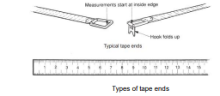
Measuring tapes (p4)
Looking after tapes Measuring tapes will last for many years if the following cautions are observed.
Don’t abuse the blade or the tape housing.
Retract the blade gently.
Keep the blade free from grit and moisture.
Avoid leaving the tool exposed for long periods to the direct rays of the sun. This can buckle the blade or degrade the housing.

Slide 35
Measuring tapes (p5)
Using tapes
Tapes can be graduated in either metric or a combination of metric and imperial (feet and inches) measurements.
The steel tape can be used in most situations, but it is best used for on-site setting out and for taking on-site measurements.
Fixed End Hook:
Compensates for metal thickness during inside or outside measurements.
Correct placement is crucial for accuracy.
Versatility:
Used for various measurements and setting out within its length range.
Eliminates errors in longer distances compared to a steel rule.
Accurate measurements on curved surfaces..

Slide 36
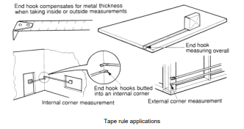
Measuring tapes (p6)

Slide 37
(n) Callipers
Callipers are classed as either inside callipers or outside callipers. An inside calliper is used with a rule to measure the internal dimensions (sizes and shapes) of parts.
An outside calliper is used with a rule to measure the external dimensions of parts. The type and construction of outside callipers is the same as the inside calliper except the legs are turned inwards.
Common types of callipers are:
Spring-joint callipers which have:
two legs
a circular spring
a pivot pin
adjustment screw

Slide 38
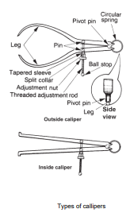
Callipers (p2) Types of callipers

Slide 39
Callipers (p3) Using callipers
Since callipers do not have a scale, they must be used with a steel rule to measure the dimensions of a part.
To measure the outside diameter of a piece of pipe using an outside calliper and a steel rule:
open the calliper legs to a distance greater than the pipe diameter by turning the adjustment nut anticlockwise
hold one leg against the pipe and turn the adjustment nut slowly clockwise
move the other leg backwards and forwards in a small arc directly across the pipe
continue to turn the adjustment nut until a slight drag is felt as the leg moves past the pipe.

Slide 40
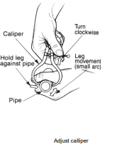
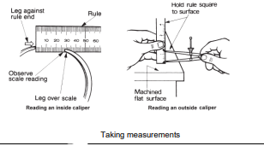
Callipers (p4) Using callipers

Slide 41
(o) Marking gauges
Marking gauges (scratch stocks, scratch gauges) are used for accurate transfer of measurements and repetition marking of metals in layout work.
There are two types of marking gauges:
Adjustable marking gauges for metalwork are similar to those used in the woodworking trades, except that they are made entirely of metal,
Fixed or scratch gauge used in mass production.
Adjustable marking gauges, there are many varieties of adjustable marking gauges. The advantage of this type of gauge is that it can be adjusted and set to mark any required distance within its capacity.

Slide 42
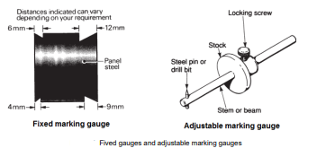
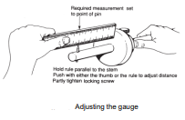
Marking gauges (p2)

Slide 43
Marking gauges (p3)
To set an adjustable gauge:
loosen the thumb screw
slide the stock along the stem to the required distance from the pin
partly tighten the thumb screw
check the distance and adjust if necessary by gently tapping the end of the stem on a solid surface, such as a bench top
when set correctly, tighten the thumb screw by hand.

Slide 44
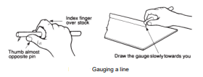
Marking gauges (p4)
To produce a line or lines parallel to the edge of a sheet:
hold the marking gauge firmly in the hand with the sharp point of the pin, pointing downwards
the thumb must be against the stem almost opposite the pin with the first finger curved over the stock
roll the hand until the point of the pin is pointing slightly away from you holding the gauge with its stock against the edge of the material, slowly draw it towards you.

Slide 45
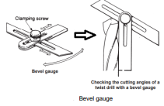
Marking gauges (p5)
Bevel gauges
Abevel gauge consists of a body with an adjustable sliding blade that may be set and clamped at an angle to the body. They are used for transferring or checking angles in many metalworking situations
Use a bevel gauge as follows.
Set the blade of the gauge to the angle required.
Lock the blade to the body with the clamping screw.
Transfer the gauge on to the work.
Compare the setting of the gauge against the angle on the work.

Slide 46
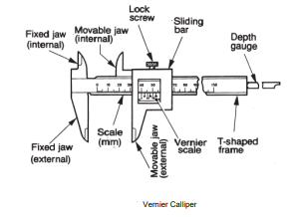
(p) Vernier callipers
A vernier calliper is used to accurately measure the internal or external dimensions of a component (part).
The common vernier calliper consists of a fixed jaw and a frame or beam along which an accurately graduated scale is engraved.
When you have finished using the vernier, it must be:
wiped clean
oiled with a suitable protective oil
stored in a protective box

Slide 47
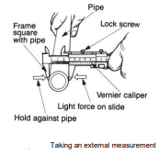
Vernier callipers (p2)
Using vernier callipers
External measurement :
To use a vernier calliper to measure the outside diameter of a piece of pipe you must do the following. Open the calliper jaws by:
loosening the lock-screw
then moving the slide and the movable jaws away from the fixed jaws.
Insert the piece of pipe between the external calliper jaws.

Slide 48
Vernier callipers (p3)
Using vernier callipers
External measurement (cont) :
Adjust the jaws to the pipe diameter by:
holding the fixed jaw against one side of the pipe
then sliding the movable jaw towards the other side of the pipe
then pressing the movable jaw against the side of the pipe while tightening the lockscrew.
Withdraw the calliper from the pipe.
Sight and record the reading on the fixed and vernier scales.

Slide 49
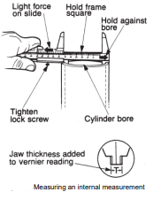
Vernier callipers (p4)
Internal measurement :
To measure the inside (bore) diameter of a cylinder with a vernier calliper you must do the following. Close the calliper jaws by:
loosening the lock-screw
then pushing the slide bar towards the fixed jaws.
Place the internal jaws into the cylinder bore
Adjusting:
Hold the fixed jaw against the bore.
Move the slide and movable jaw to the other side.
Apply slight force, tighten the lock-screw.

Slide 50
Vernier callipers (p5)
Reading the scales on a vernier calliper
Locate the zero (0) on the vernier scale and note its position on the fixed scale.
If the vernier scale lacks numbers, use the leftmost graduation.
Record the number above the nearest large graduation on the fixed scale to the left of the zero on the vernier scale.
For millimeter scales, write the full number (e.g., 10 mm); for those marked in centimeters, drop one zero (e.g., 100 becomes 10 mm).
Count the small graduations between the large graduation and the zero.
Write this number to the right of the first, placing a decimal point after it (e.g., seven small graduations become 107.0 mm).
Align one of the vernier scale graduations with a fixed scale graduation for accurate reading.

Slide 51
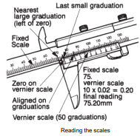
Vernier callipers (p6)
Reading the scales on a vernier calliper

Slide 52
(q) Engineers spirit level
Engineers use spirit levels to level machines and large workpieces, ensuring straight machine axes.
Precision levels are employed in the engineering field, with adjustable versions capable of measuring inclinations.
In building construction, carpenters and masons utilize spirit levels.
Accuracy can be checked by marking the bubble's position on a flat surface and rotating the level 180°; the bubble should be symmetrical.
Machinist's levels include screw mechanisms for bubble centering.

Slide 53
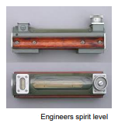
Engineers spirit level (p2)

Slide 54
KT0103 Explain and discuss basic units of measure and symbols & KT0104 includes derived units of measure
In addition to the conventional measuring instruments, we also have digital and electronic measuring instruments. We will discuss these instruments together with the conventional measuring instruments.
Vocabulary :
Constant reading – readings remaining the same
Datum line – a fixed starting-point of a scale
Test piece – to determine whether the zero reading is correct
Slackness – the amount of wear on the micrometer spindle

Slide 55

Scientific notation and metric prefixes
Scientific Notation Very large or very small numbers are conveniently written as a number multiplied by 10 raised to a power:
Numbers in scientific notation are presented with spaces instead of commas in the SI system.
Exception: Four-numeral numbers use commas.
Example: 1000 (one thousand), 10 000 (ten thousand).

Slide 56
Scientific notation and metric prefixes(p2)
Metric Prefixes and Symbols:
Metric prefixes simplify representation of large and small quantities.
Example: 1000 expressed as 1 kilo-ohm (1 k).
Common electrical units use prefixes (e.g., kilo represented by 'k') for convenience.
Example: 1 x 10^(-3) A written as 1 milli-ampere (1 mA).

Slide 57
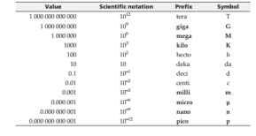
Scientific notation and metric prefixes(p3)
Scientific Notation and Metric Prefixes

Slide 58
(b) Engineering notation
Note also from Table 1 that 1 x 106 is expressed as 1 M, and 1x 10-6 A can be written as 1 µA. These quantities, and most of the metric prefixes in Table 1, involve multiples of 103 or 10-3 . Quantities that use 103 or 10-3 are said to be written in engineering notation. A quantity such as 1 x 104 is more conveniently expressed as 10 x 103 , or 10 k. Also, 47 x 10-4 A is best written as 4.7 x 10-3 A, or 4.7 mA.
For electrical calculations, engineering notation is more convenient than ordinary scientific notation.

Slide 59
(c) The SI mechanical units
Fundamental Mechanical Units as discussed above, the three fundamental mechanical units in the SI system are:
Unit of length: the meter (m)
Unit of mass: the kilogram (kg)
Unit of time: the second (s)
THE METER was originally defined as one ten-millionth of a meridian passing through Paris from the North Pole to the equator.
b) THE KILOGRAM was defined as 1000 times the mass of one cubic centimetre of distilled water.
c) THE LITER is 1000 times the volume of one cubic centimetre of liquid. Consequently, one litre of water has a mass of 1 kilogram.

Slide 60

(d) Unit of force
The SI unit of force is the newton (N), defined as that force which will give a mass of 1 kilogram an acceleration of one meter per second per second.
When a body is to be accelerated or decelerated, a force must be applied proportional to the desired rate of change of velocity, that is, proportional to the acceleration (or deceleration).

Slide 61

Unit of force(p2)
Equation 1-1 gives the force in “newton” when the mass is in kilograms and the acceleration is in m/s2 . If the body is to be accelerated vertically from the earth’s surface, the acceleration due to gravity (g) must be overcome before any vertical motion is possible. In SI units:
Thus, a mass of 1 kg has a gravitational force of 9.81 N.

Slide 62

Unit of force(p3)
(a) Work
When a body is moved, a force is exerted to overcome the body’s resistance to motion.
The work done in moving a body is the product of the force and the distance through which the body is moved in the direction of the force.
The SI unit of work is the joule2 (J), defined as the amount of work done when a force of one newton acts through a distance of one meter. Thus, the joule may also be termed a newton-meter. For the equation W = F d, work is expressed in joules when F is in newton and d is in meters.

Slide 63
Unit of force(p4)
(b) Power
Power is the time rate of doing work
If a certain amount of work W is to be done in a time t, the power required is Power = work time P = W t (1-4) The SI unit of power is the watt3 (W), defined as the power developed when one joule of work is done in one second.
For P = W/t, P is in watts when W is in joules and t is in seconds.
Named for the great English philosopher and mathematician Sir Isaac Newton (1642– 1727).
Named after the English physicist James P. Joule (1818–1899).
Named after the Scottish engineer and inventor James Watt (1736–1819).

Slide 64
Unit of force(p5)
(c) Energy
Energy is defined as the capacity for doing work.
Consequently, energy is measured in the same units as work. When 1 W of power is used for one hour, the energy consumed (or work done) is one watt-hour (1 Wh). When 1 kW is used for one hour, 1 kilo-watthour (1 kWh) of energy is consumed.
Recall that power is the time rate of doing work, and that a power of 1 W represents a work rate of one joule per second (1 J/s). Therefore, when 1 W of power is dissipated for 1 s, 1 J of energy is consumed, or 1 J of work is done.
Similarly, when 1 kW of power is expended for 1-minute Energy consumed = 1 kW 60 s = 60 kJ and when 1 kW is expended for 1 hour, Energy consumed = 1 kW × 60 s × 60 min = 3600 kJ = 3.6 MJ

Slide 65
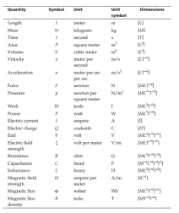
(e) Measurement of dimensions

Slide 66
Measurement of dimensions (p2)
General rules of measuring
Engineering measurements are performed in millimetres (mm) for precision engineering machining.
When using a steel rule – always use millimetres as a measurement result. “Centimetres” are typically used in the clothing and textiles industry [example: dressmakers use centimetre measuring tapes]
When measuring open spaces, it is often expected that you use “meters” in terms of your end result [Example: measurement of the size of a room could be read as 1,24 m x 3,5 m] – usually within the civil engineering and construction industry.
Cabinet makers and joiners use “millimetres” during all measuring tasks.
Engineering precision measurement requires that you perform basic metric and decimal conversions, example:
Divide 1 mm into 10 = 0,1 mm
Divide 0,1 mm into 10 = 0,01 mm
Divide 0,01 mm into 10 = 0,001 mm

Slide 67
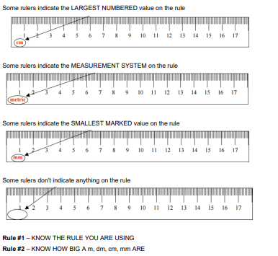
(f) The metric steel rule
a meter (m) is a little bigger than a yard
a decimetre (dm) is about the width of your hand
a centimetre (cm) is about the width of your finger
a millimetre (mm) is about the thickness of your fingernail

Slide 68
The metric steel rule (p2)
Using a Metric Ruler WITH a VISIBLE 0 mark
Set one end of the object at the zero point
Read the measurement at the other end of the object
If the end of the object lands between two numbers use the lesser number
Each mm is 0,1 cm so just count the number of mm lines from the last cm and put that after the decimal point

Slide 69
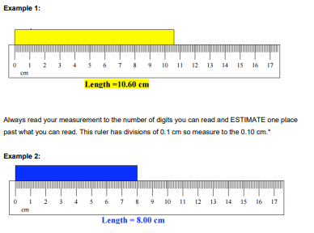
The metric steel rule (p3)

Slide 70
The metric steel rule (p4)
Using a Metric Ruler WITHOUT a VISIBLE 0 mark
Set one end of the object at a numbered mark that is visible such as the 1.0 cm or 1.00 dm mark Read the measurement at the other end of the object
If the end of the object lands between two numbers use the lesser number
Each mm is .1 cm so just count the number of mm lines from the last cm and put that after the decimal point
Subtract from your measurement the number the object was started at.

Slide 71
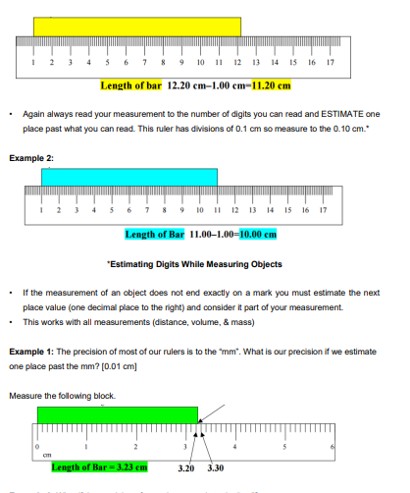
The metric steel rule (p5)

Slide 72
KM-08-KT02: Apply care and maintenance of engineering measuring equipment
After completing this topic, you the learner will be able to demonstrate an understanding of:
KT0201 Identify and report unsafe or faulty measuring equipment
KT0202 Clean, service and maintain measuring equipment
KT0203 Damaged or faulty measuring equipment includes deformities, breakages, stickiness, not zeroing, missing parts, expired calibration.
KT0204 Maintenance of measuring equipment includes oiling, setting and calibration.
KT0205 Problems are reported timeously to appropriate personnel

Slide 73
KT0201 Identify and report unsafe or faulty measuring equipment.
Care of Measuring Equipment:
Tool condition reflects a welder's efficiency and skill.
Precision tools like micrometers require delicate handling and precision.
Skilled artisans maintain tools with care and precision.
Tools have designated places, are kept clean, and lubricated to prevent rust.
Lubrication recommended under extreme conditions (humidity, moisture, salt air).

Slide 74
KT0202 Clean, service and maintain measuring equipment & KT0203
Care of Callipers:
Handle callipers with care, wipe off perspiration and fingerprints.
Avoid forcing threaded parts, use gentle touch measurements.
Do not spring or clamp callipers; store in case or wrap in a soft cloth.
Lubricate threaded and moving parts with preservative oil.
Clean after each use to prevent dirt accumulation and loss of calibration.
Wipe tools with anti-rust oil; store in original case or wrap in a clean, soft cloth.
Periodic cleaning, inspection, and repair are essential for proper maintenance.
Disassemble, wash parts in dry cleaning solvent, inspect, and lubricate as needed.

Slide 75
KT0204 Maintenance of measuring equipment includes oiling, setting and calibration
Reasons for Lubrication of Instruments:
Prevent Damage: Lubrication prevents oxidation and corrosion, avoiding damage to precision tools.
Remove Excess Oil: After use, lightly oil instruments and remove excess oil with a clean, soft cloth.
Avoid Attracting Particles: Wet instruments can attract tiny particles, causing internal wear and irreparable damage.
Select Correct Lubricant: Choose the right oil to avoid altering calibration; avoid penetrating oils or multi-purpose lubricants like WD-40.
Avoid Foreign Substances: Precision instruments are sensitive; even a thin layer of foreign substance can lead to measurement inaccuracies.

Slide 76
KT0205 Problems are reported timeously to appropriate personnel.
This is a legal requirement as by the Occupational Health and Safety Act of 1993 mandates immediate reporting of faulty machinery posing risks.
It also assist in measuring Equipment: Faulty measuring equipment must also be reported to ensure productivity and worker safety.
Incident Reporting Criteria:**
Fracture or failure resulting in falling or flying objects.
Machinery running out of control due to control or safety equipment failure.
Fracture or failure in pressurized machinery leading to the sudden release of gas.

Slide 77
KM-08-KT03: Store engineering power tools in a safely designated area
After completing this topic, you the learner will be able to demonstrate an understanding of:
KT0301 Engineering measuring equipment is stored as per storage management specifications
KT0302 Safely store different measuring equipment orderly according to their classifications
KT0303 Store engineering measuring equipment in a lock up safely designated area
KT0304 Procedures for storing different engineering measuring equipment must be maintained
KT0305 Safety inspection and records of stored engineering measuring equipment tools are administered
KT0306 Recognize and report problems, changes and/or malfunctions while storing engineering measuring equipment

Slide 78
KT0301 Engineering measuring equipment is stored as per storage management specifications
Efficient Material Handling is key as all operations involve hoisting steel with cranes, driving loaded trucks, manual carrying, and palletized stacking.
This is vital for industry, ensuring continuous flow of tools, equipment, and parts through the workplace.
Critical for timely availability of tools and equipment.
Improper handling leads to costly injuries.
Importance of storing Hand Tools Safely:
Besides training, prioritize safety principles in work practices and equipment handling.
Reduce accidents by understanding and controlling hazards in manual or mechanical material handling.
Empower employees to minimize workplace dangers.

Slide 79
KT0302 Safely store different measuring equipment orderly according to their classifications
Use optimal Instrument Storage:
Store instruments in an environment suitable for their well-being.
Avoid wet or locations prone to vibrations to prevent calibration issues.
Use protective cases to prevent instruments from banging or hitting each other.
Minimize stacking or arranging instruments on top of each other without protective cases.
Address humidity or moisture issues with silica gel packs, air conditioning, or dehumidifiers.
Regularly examine workplaces for unsafe conditions, practices, or equipment, taking corrective actions promptly.

Slide 80
KT0302 Safely store different measuring equipment orderly according to their classifications
Criteria for a safely designated area:
Employers should make a dedicated space available – for a storeroom for the storage of tools, measuring equipment and consumables
The storeroom should have shelving and fixtures for the safe storage and issuing to workers of all tools, equipment and consumables. This must be executed in the most convenient way possible with no risk to worker safety.
The store should be staffed by a suitably qualified person/persons - trained to conduct storekeeping activities.
An administration system must be developed which allows for the documenting of all tools issued to - and all tools returned by workers.
A company policy must be established for the control of new tool/equipment purchases, equipment redundancies, decommissioning and re-issuance procedures.

Slide 81
KT0304 Procedures for storing different engineering measuring equipment must be maintained
Optimize accessibility and ensure easy access to commonly used welding tools, reducing time wasted on tool retrieval.
Theft Prevention, implement a secure storekeeping system to safeguard tools and equipment from theft.
Classification Efficiency, properly categorize tools to facilitate easy identification, minimizing time spent searching. Examples include:
- Striking tools: hammers
- Deburring tools: hand files, deburring tool, etc.
- Abrasive tools: emery paper, pencil grinder, orbital sander, etc.
- Measuring and leveling tools: gauges, spirit level, theodolite, measuring tape, steel rule, etc.
- Inspection tools: crack detection equipment, telescopic mirror, fillet weld gauge, etc.
- Marking off tools: scriber, dividers, centre punch, etc.
- Jigs and fixtures: clamps, blocks, angle-plates, etc.
- Cutting tools: hacksaws, jig-saws
- Pliers, Wrenches (Spanners), and more.

Slide 82
KT0304 Procedures for storing different engineering measuring equipment must be maintained (p2)
Storekeeping Criteria, storerooms in fabrication and welding workshops should meet the following standards:
Adequate Staffing, involves dedicated personnel for record-keeping, safe storage, and maintenance.
Record Keeping, maintain proper records of tools, conduct regular stocktaking, and monitor losses.
Maintenance and Calibration, helps ensure tools and equipment are in safe and calibrated conditions, attending to repairs promptly.
Replacement Planning, needed to identify the need for tool and equipment replacement and reorder defective items.
Budget Preparation. key to liaise with sales representatives for budget preparation and quotations for equipment replacement.

Slide 83
KT0305 Safety inspection and records of stored engineering measuring equipment tools are administered
Factors for administration of safety inspections and records:
Applications of different hand tools in a general engineering context
Common faults and/or defects in hand tools
Procedures for marking unsafe or faulty tools for repair routine maintenance requirements for a range of hand tools storage location
Procedures for a range of hand tools hazards and control measures associated with using hand tools use
Application of personal protective equipment (PPE)

Slide 84
KT0306 Recognize and report problems, changes and/or malfunctions while storing engineering measuring equipment.
Optimal Storage Practices for Instruments:
Environment Consideration: Store instruments in an optimal environment, avoiding wet or damp locations.
Avoid Impact: Prevent precision tools from banging into each other or hitting storage walls by arranging them with care.
Padding Protection: Ensure instrument cases are well padded to safeguard against potential damage.
Avoid Stacking: Refrain from stacking instruments on top of each other unless placed in protective cases.
Vibration Management: If unavoidable vibrations are present, position measuring instruments far from the source to prevent calibration issues.
Moisture Control: Reduce humidity by employing methods like silica gel packs, air conditioning, or, in extreme cases, a dehumidifier.

Slide 85
Assessment activity
List SIX of the skills that fabrication workers in the light and heavy industries have in common.
List FOUR pieces of information that can be found on a drawing of a fabrication job.
To manufacture an article, what SIX things must be done?
State THREE methods used to calculate material cutting sizes.
List FIVE types of marking out tools.
Briefly discuss the FIVE main reasons why it is necessary to have proper storage procedures.

Slide 86

The End

